Slide 1
Telco Customer Churn Analysis
A Business Intelligence Dashboard Built Using Microsoft Power BI
👤 Prepared by
Kaartik Chugh
MBA Candidate
Business & Data Analytics Enthusiast

Slide 2
Business Problem
Business Challenge
The telecom company is experiencing customer churn, leading to reduced recurring revenue and increased customer acquisition costs.
Without understanding why customers leave, the business cannot implement targeted retention strategies or reduce financial losses.
Why It Matters
Revenue decreases when customers leave.
Acquiring new customers costs more than retaining existing ones.
High churn affects long-term profitability and customer lifetime value.
Data-driven insights help identify at-risk customer segments.
Telecom Customers
Customer Churn
Revenue Loss
Which customer segments are most likely to churn, and what actions can reduce churn while protecting revenue?
Higher Acquisition Costs
Need for Data-Driven Retention Strategy

Slide 3
Project Objectives
Define the analytical goals and business outcomes of the customer churn analysis.
Identify Churn Drivers
Measure Business Impact
Determine the key factors influencing customer churn.
Quantify revenue loss and identify customers at financial risk.
Analyse Customer Behaviour
Support Decision-Making
Segment customers based on demographics, services, and contracts.
Deliver actionable insights to improve customer retention.
Success Criteria
Identify high-risk customer segments
Quantify revenue at risk
Enable data-driven retention strategies

Slide 4
Dataset Overview
Understanding the customer data used to analyse churn behaviour.
Customer Profile
Gender
Senior Citizen
Partner
Dependents
7,043
Customers
Services
Internet Service
Phone Service
Tech Support
Online Security
21
Features
Target
Account & Financial
Contract
Payment Method
Monthly Charges
Total Charges
Tenure
Churn Yes/No
IBM
Sample Dataset
Target Variable
Customer Churn (Yes/No)

Slide 5
Project Methodology
A structured approach was followed to transform raw customer data into actionable business insights.
Dataset
Imported IBM Telco Customer Churn dataset.
Data Cleaning
Handled missing values and corrected data types.
Data Transformation
Prepared and structured data using Power Query.
Dashboard Development
Designed interactive Power BI dashboards.
DAX Measures
Created KPIs and calculated business metrics.
Business Insights
Identified churn patterns and business recommendations.

Slide 6
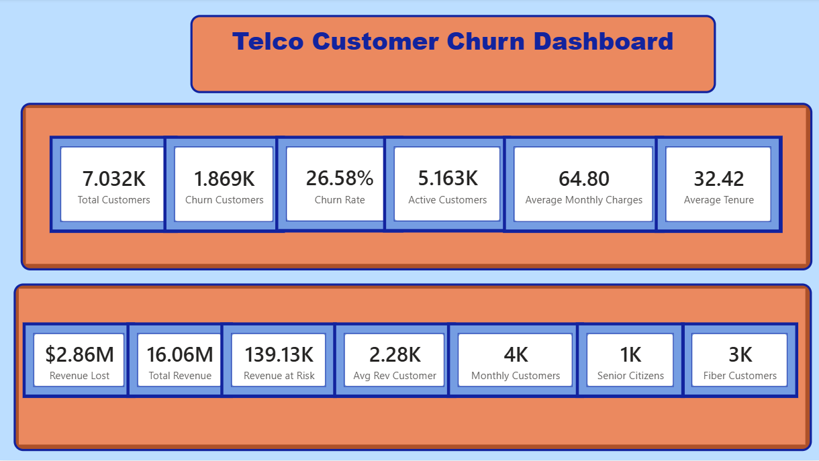
Executive Dashboard
Key Highlights
26.58% overall customer churn rate
5.16K active customers retained
139K revenue currently at risk
Average customer tenure of 32.4 months
Microsoft Power BI Dashboard

Slide 7
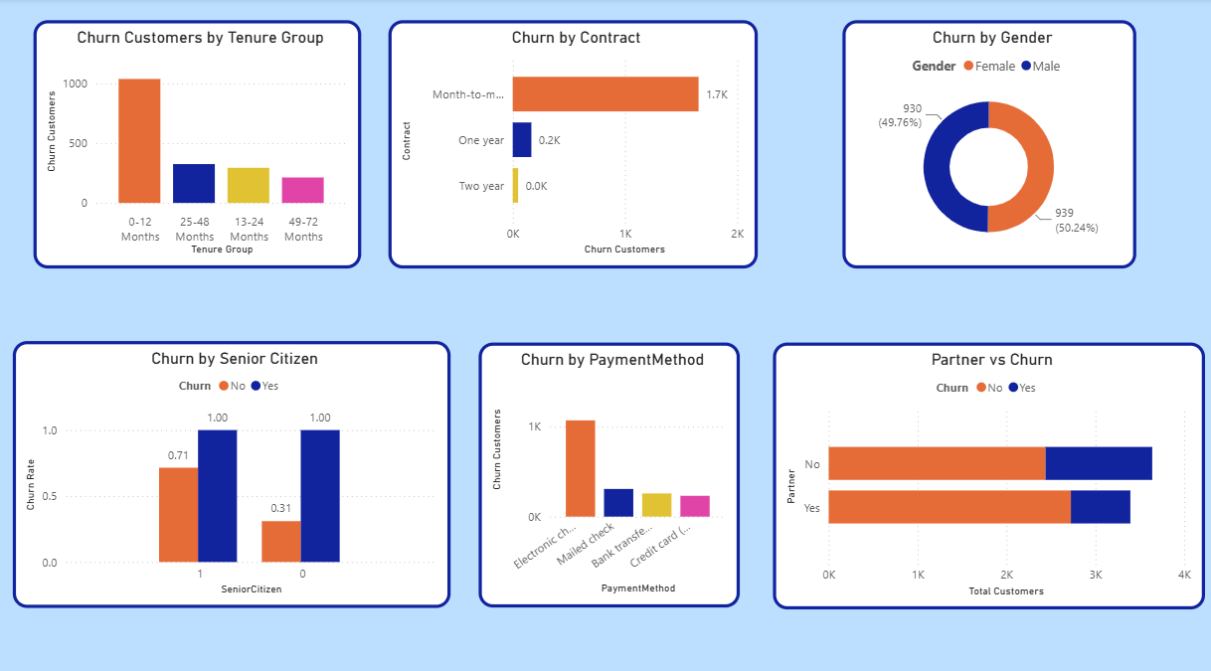
Customer Churn Analysis
Key Highlights
Month-to-month contracts have the highest churn.
Customers within the first 12 months are most likely to leave.
Customers without partners exhibit higher churn.
Senior citizens experience a relatively higher churn rate.
Microsoft Power BI Dashboard

Slide 8
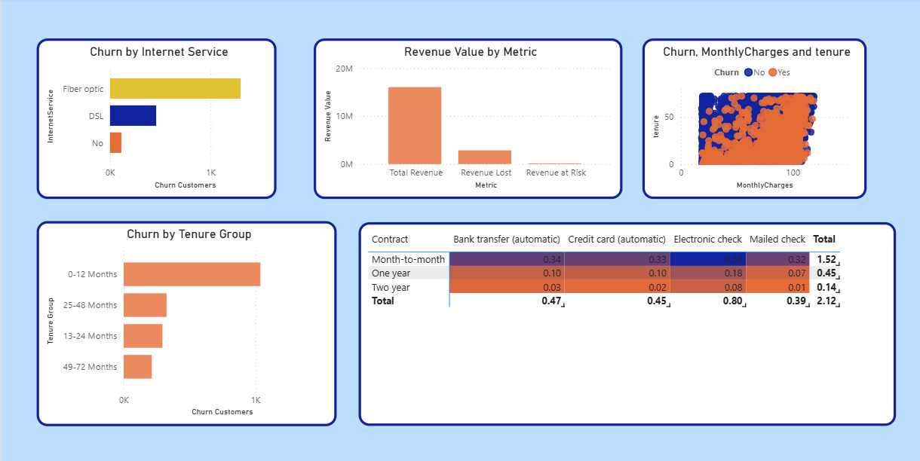
Customer Churn Analysis
Key Highlights
Month-to-month contracts have the highest churn.
Customers within the first 12 months are most likely to leave.
Customers without partners exhibit higher churn.
Senior citizens experience a relatively higher churn rate.
Microsoft Power BI Dashboard

Slide 9
Key Findings
Highest Churn
Month-to-month contracts experience the highest customer churn.
Early Customer Loss
Most customers who churn leave within their first year.
High-Risk Segments
Senior citizens and customers without partners exhibit relatively higher churn.
Revenue at Risk
Approximately 139K in revenue is associated with customers at risk of churn.
Business Opportunity
Targeted retention strategies can reduce churn and improve long-term customer value.

Slide 10
Business Recommendations
Promote Long-Term Contracts
Encourage customers on month-to-month plans to switch to annual or multi-year contracts through discounts and loyalty incentives.
Improve First-Year Customer Experience
Strengthen onboarding, proactive communication, and customer engagement during the first 12 months to reduce early churn.
Target High-Risk Customer Segments
Develop personalized retention campaigns for senior citizens and customers without partners using targeted offers and support.
Prioritize High-Value Customers
Monitor customers with higher revenue contribution and implement proactive retention strategies before churn occurs.
Enhance Value-Added Services
Promote services such as Tech Support and Online Security through bundled plans to increase customer satisfaction and loyalty.

Slide 11
Project Summary
Project outcomes and technologies used throughout the analysis.
Project Outcome
Successfully analyzed customer churn patterns and key business drivers.
Built an interactive Power BI dashboard.
Identified key business insights.
Developed data-driven recommendations.
Demonstrated business-focused analytical storytelling.
Tools & Technologies
Microsoft Power BI
Power Query
DAX
Microsoft Excel
IBM Telco Customer Churn Dataset (Sample Data)
Microsoft PowerPoint
This project demonstrates how data-driven analytics can support strategic business decisions and improve customer retention

